Slide 1

A Comparative Study on Fake Job Post Prediction Using Different Data mining Techniques
MALLA REDDY ENGINEERING COLLEGE
Department of Information Technology
Under the Guidance of
Mr. M. Srinivasa Reddy
Assistant Professor
Presented by:
Kesireddy Samara Simha Reddy [18J41A1227]
Jangiti Dwarakamai [18J41A1224]
Motha Rahul [18J41A1233]
CH Yogesh Chowdary [19J41A1201]

Slide 2
CONTENTS
Abstract
Introduction
Existing System
Proposed System
Advantages
Disadvantages
Software Requirements
Algorithms Used
Modules
Uml Diagrams
Outputs
Conclusion

Slide 3
ABSTRACT
In recent years , due to advancement in modern technology and social communication, advertising new job posts has become very common issue in the present world. This paper proposed to use different datamining techniques and classification algorithm like KNN, decision tree, support vector machine, naive bayes classifier, random forest classifier , multi layer perceptron and deep neural network to predict a job post if it is real or fraudulent. We have experimented on Employment Scam Aegean Dataset (EMSCAD) containing18000 samples. Deep neural network as a classifier, performs great for this classification task. We have used three dense layers for this deep neural network classifier. The trained classifier shows approximately 98% classification accuracy (DNN) to predict a fraudulent job post.

Slide 4

INTRODUCTION
In modern time, the development in the field of industry and technology has opened a huge opportunity for new and diverse jobs for the job seekers.
Instead of this, rapid growth of opportunity to share job posts has increased the percentage of fraud job postings which causes harassment to the job seekers. So, people lacks in showing interest to new job postings due to preserve security and consistency of their personal and professional information. Thus the true motive of valid job postings through social and electronic media faces an extremely hard challenge to attain people's be lictand reliability.

Slide 5

EXISTING SYSTEM
Many researches occurred to predict if a job post is real or fake. They experimented on EMSCAD dataset using several classification algorithms like naive bayes classifier, random forest classifier, Zero R, One R etc. Random Forest Classifier showed the best performance on the dataset with 89.5% classification accuracy. They found logistic regression performing very poor on the dataset. One R classifier performed well when they balanced the dataset and experimented on that. They tried in their work to find out the problems in ORF model (Online Recruitment Fraud) and to solve those problems using various dominant classifiers.

Slide 6
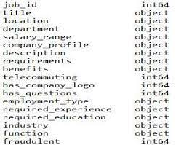
PROPOSED SYSTEM
The system has used EMSCAD to detect fake job post. This dataset contains 18000 samples and each row of the data has 18 attributes including the class label. The attributes are job_id, title, location, department, salary_range, company_profile, description, requirements, benefits, telecommunication, has_company_logo, has_questions, fraudulent (class label). Among these 18 attribute, we have used only 7 attributes which are converted into categorical attribute. Telecommuting, has company_logo, has_questions, employment_type, and fraudulent are changed into categorical value from text value. For example, “employment_type” values are replaced like this- 0 for “none”, 1 for ‘full-time”, 2 for “part-time” and 3 for “others”, 4 for “contract’ and 5 for “temporary”.

Slide 7
ADVANTAGES
1) The proposed method has been implemented EMSCAD technique which is very accurate and fast.
2) The system is very effective due to accurate detection of Fake job posts which creates inconsistency for the job seeker to find their preferable jobs causing a huge waste of their time.

Slide 8
DISADVANTAGES
1) The system is implemented by Conventional Machine Learning.
2) The system doesn’t implement for analyzing large data sets.

Slide 9

PROBLEM STATEMENT
This project aims to create a classifier that will have the capability to identify fake and real jobs. The final result is evaluated based on two different models. Since the data provided has numeric and text features, one model will be used on the text data and another on numeric data. The final output will be a combination of the two. The final model will take in any relevant job posting data and produce a final result determining whether the job is real or not.

Slide 10
SOFTWARE REQUIREMENTS
SYSTEM REQUIREMENTS:
Hardware System Configuration:
Processor - Pentium –IV
RAM - 4 GB (min)
Hard Disk - 20 GB
Key Board - Standard Windows Keyboard
Mouse - Two or Three Button Mouse
Monitor - SVGA

Slide 11
SOFTWARE REQUIREMENTS
SOFTWARE REQUIREMENTS:
Operating system : Windows 7 Ultimate.
Coding Language : Python.
Front-End : Python.
Back-End : Django-ORM
Designing : Html, CSS, Javascript.
Data Base : MySQL (WAMP Server).

Slide 12
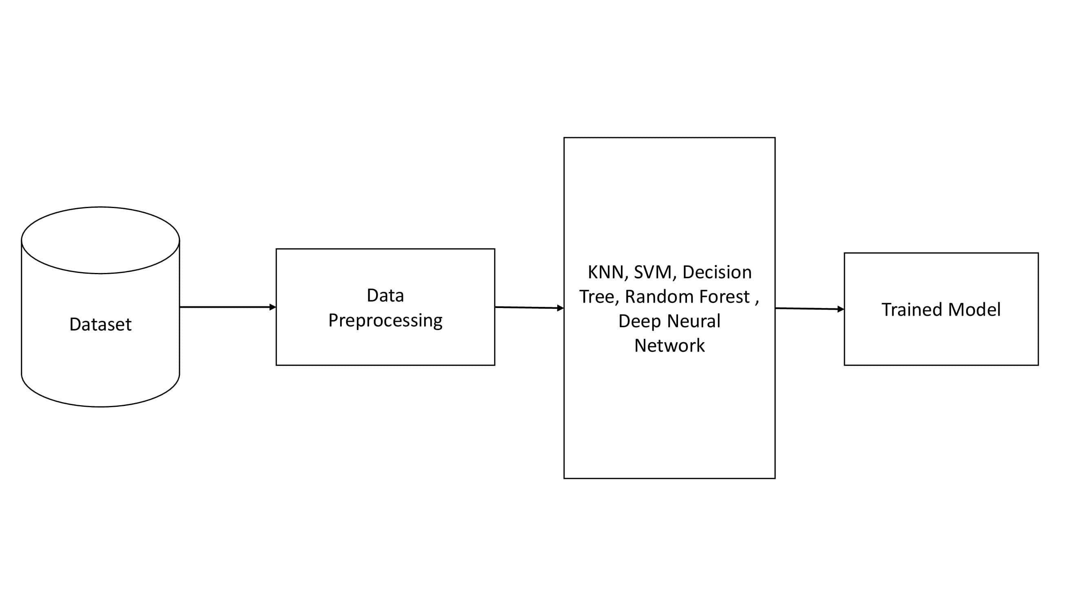
METHODOLOGY & ALGORITHM

Slide 13
1.RANDOM FOREST ALGORITHM:
Step-1: Select random K data points from the training set.
Step-2: Build the decision trees associated with the selected data points (Subsets).
Step-3: Choose the number N for decision trees that you want to build.
Step-4: Repeat Step 1 & 2.
Step-5: For new data points, find the predictions of each decision tree, and assign the new data points to the category that wins the majority votes.
Random random = new Random(System.currentTimeMillis())

Slide 14
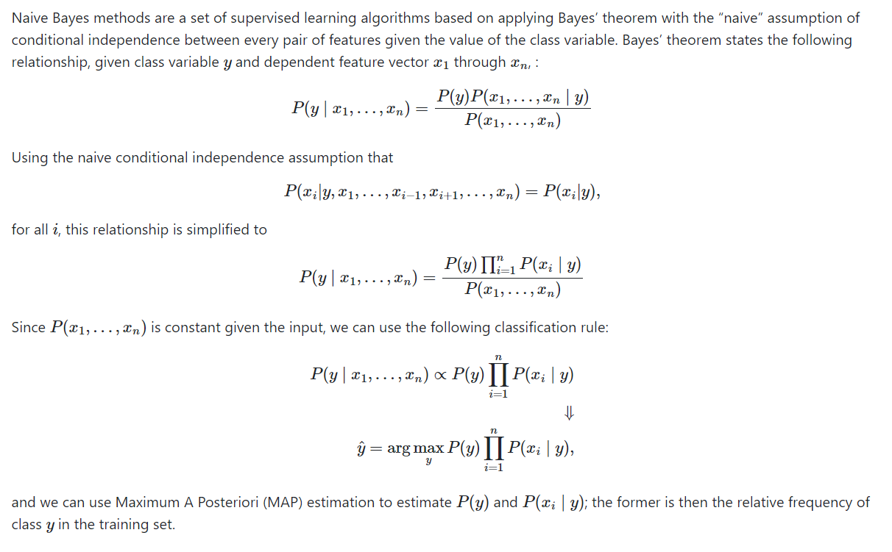
2.NAIVE BAYES

Slide 15


MODULES USED
SERVICE PROVIDER
REMOTE USER

Slide 16
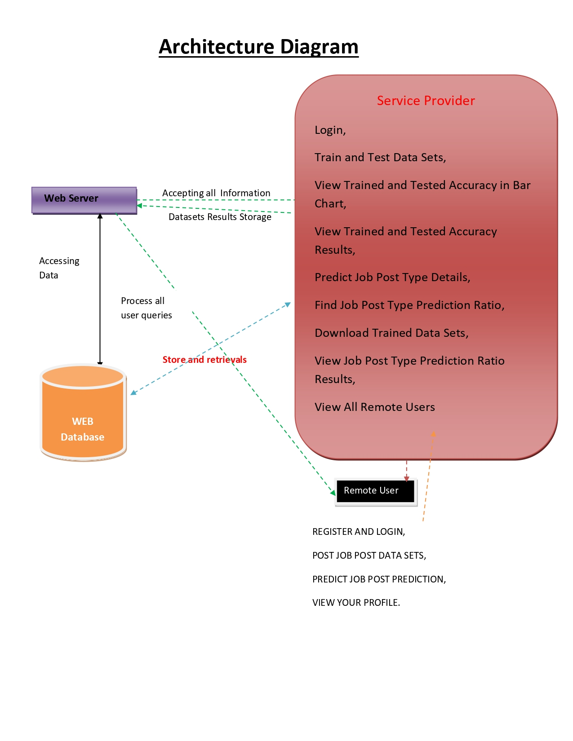

Slide 17
RESULTS
All the above mentioned classifiers are trained and tested for detecting fake job posts over a given dataset that contains both fake and legitimate posts. The following Table shows the comparative study of the classifiers with respect to evaluating metrics and Table provides results for the classifiers that are based on ensemble techniques. Overall performance of all the classifiers in terms of accuracy, f1-score, Cohen-kappa score, MSE respectively.

Slide 18

OUTPUTS
Remote user login and signup page

Slide 19

Service Providers Login page

Slide 20
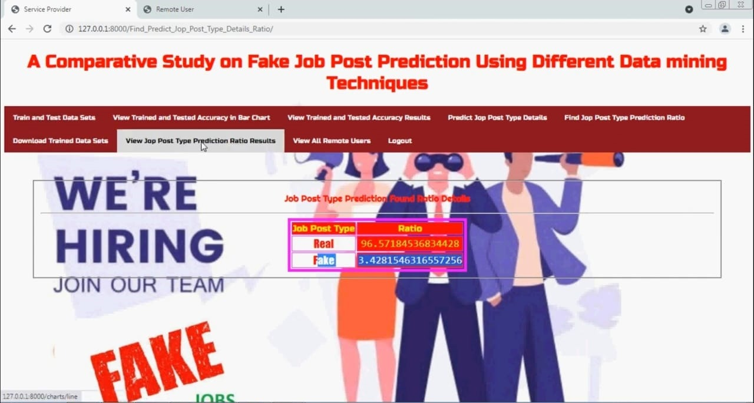
Real or Fake prediction of required job

Slide 21
CONCLUSION
Employment scam detection will guide job-seekers to get only legitimate offers from companies. For tackling employment scam detection, several machine learning algorithms are proposed as countermeasures in this paper. Supervised mechanism is used to exemplify the use of several classifiers for employment scam detection. Experimental results indicate that Random Forest classifier outperforms over its peer classification tool. The proposed approach achieved accuracy 98.27% which is much higher than the existing methods.

Slide 22
Thank You..!

